Slide 1


A comprehensive Study on Credit Card Fraud detection using Feature Selection Methods and Machine Learning
By
Md. Mostafijur Rahman
Al Mahmud Siam
SID: 1902073
SID: 1902062
Date: 19/02/2024

Slide 2


Outline
Introduction
Experiments Results
Statement of the Problem
Limitations and Future Work
Objectives
Conclusion and Future Work
Related works
References
Proposed Framework
Dataset
Feature Selection Techniques
Models Used in Proposed Framework

Slide 3

Introduction
Credit Card is a plastic card issued to users as a System of ePayment.
Credit Card Security relies on the Physical Security of the plastic card and the privacy of the Credit Card Number.
Globalization and increased use of Internet has resulted in a considerable proliferation of Credit Card Transactions throughout the world.
Credit Card Fraud is termed as a criminal duplicity or international deception with the intention of making a profit—mostly financial.
Need to prevent fraudulent activities using modern technology.

Slide 4

Statement of the Problem
With the immense use of the internet, fraudulent transactions increased day by day so the card cardholders fell in financial losses.
Modern technology such as machine learning techniques is used to prevent the issue.
By modeling past credit card transactions with the knowledge of the ones that turned out to be fraud.

Slide 5
Objectives
The primary objective of credit card fraud detection is to identify unauthorized or fraudulent transactions.
Detecting and preventing fraudulent transactions help minimize financial losses for both cardholders and financial institutions.
Building and maintaining customer trust.
When customers feel confident that their transactions are secure, they are more likely to continue using credit cards for payments..
Contributes to the overall security of the payment ecosystem.

Slide 6
Related Works
Ref. | Year | Title | Author Name | Contribution | Observation
[1] | 2022 | A machine learning based credit card fraud detection using the GA algorithm for feature selection | E. Ileberi, Y. Sun, and Z. Wang | Discussed Genetic Algorithm feature selection technique and applied ML models | Only one feature selection technique is used and limited no. of ML algorithms are used
[2] | 2022 | Hybrid machine learning approach for anomaly detection | Lai Kai Lok, Vazeerudeen Abdul Hameed, Muhammad Ehsan Rana | Proposed two variants of hybrid models combining supervised and unsupervised machine learning techniques. | Resampling techniques on dataset are less applied and feature selection techniques are not applied
[3] | 2020 | Credit Card Fraud Detection Using Enhanced Random Forest Classifier for Imbalanced Data | Aburbeian, A. H. M., & Ashqar, H. I. (2023). | Proposed a Random Forest model after applying SMOTE and checked performance | Other machine Learning algorithms are not shown those have the accurate classification characteristics

Slide 7
Related Works (Contd.)
Ref. | Year | Title | Author Name | Contribution | Observation
[4] | 2020 | Analysis of Credit Card Fraud Data using PCA | V. V. Madhav and K. A. Kumari | Analysis of dataset using PCA then apply K-means Clustering method for detection | Other classifiers are not shown here and dataset handling not improved
[5] | 2020 | Ensemble learning for credit card fraud detection | Sohony, R. Pratap, and U. Nambiar | Presented an ensemble method – based on a combination of random forest and neural network | Ensemble Methods shows only to the random forest algorithms and Neural network. We can apply more algorithms in this methods
[6] | 2021 | Detecting Credit Card Fraud by Decision Trees and Support Vector Machines | Y. Sahin and E. Duman | Two algorithms are used in detection model with comparison using the real dataset | Other data mining algorithms such as different versions of ANN and LR will be used to build new classification models on the same real world dataset

Slide 8
Related Works (Contd.)
Ref. | Year | Title | Author Name | Contribution | Observation
[7] | 2017 | Application of Random Forest Algorithm on Feature Subset Selection and Classification and Regression, | K. Jaiswal and R. Samikannu | Discussed Genetic Algorithm feature selection technique and applied ML models | Only one feature selection technique is used and limited no. of ML algorithms are used
[8] | 2022 | “Enhanced Credit Card Fraud Detection Model Using Machine Learning | N. S. Alfaiz and S. M. Fati, | Proposed two variants of hybrid models combining supervised and unsupervised machine learning techniques. | Resampling techniques on dataset are less applied and feature selection techniques are not applied
[9] | 2020 | Credit card fraud detection using naive Bayesian and C4.5 decision tree classifiers | Admel Husejinović1 | Proposed a Random Forest model after applying SMOTE and checking performance | To apply any the methods, it’s mandatory to know about the type of the color blind.

Slide 9
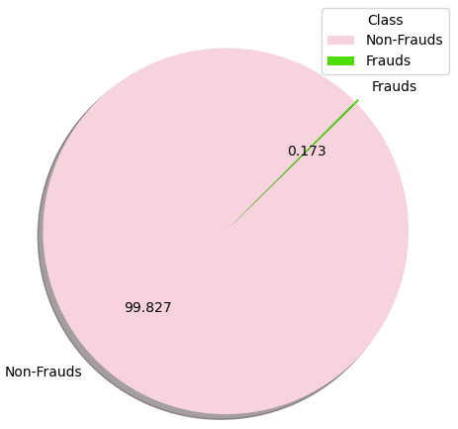
Dataset Description
Dataset Collection:
From Kaggle (European cardholders' September 2013 MasterCard transactions)
Dataset Characteristics:
Size of Dataset: 63MB
Type: imbalanced (only 492 cases of fraud out of 284807 )
No. of features: 31
No. of observations: 284,807
Class Distribution of Dataset

Slide 10
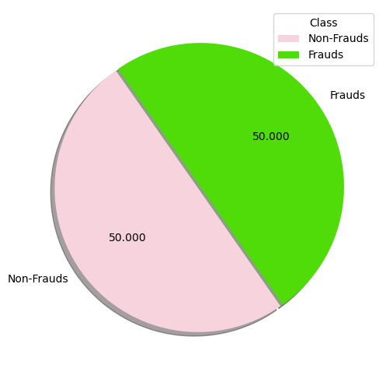
Dataset Handling
Class Distribution Before Applying SMOTE on training dataset
Class Distribution After Applying SMOTE on training dataset

Slide 11
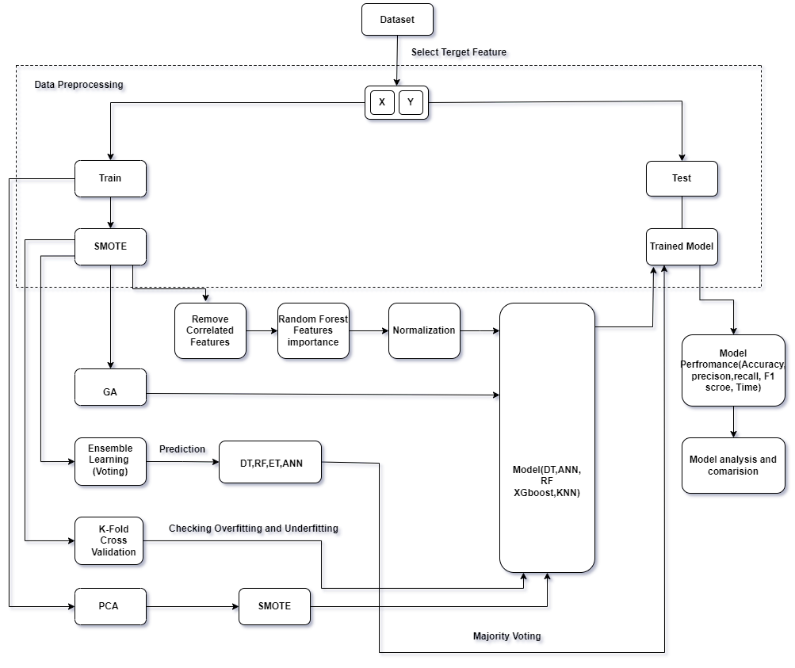
Proposed Framework

Slide 12
Apply Different Methods
Remove correlated features then apply random forest feature selection to collect the important features.
Apply dimensionality reduction algorithm of pca to create a new, smaller set of features that contain most useful data.
Apply evolutionary algorithm called genetic algorithm to select the fitness value for every generations.
Apply ensemble learning voting on multiple model DT, ET, RFT and ANN make the predictions then combine the prediction to get final result.
Checking overfitting , underfitting and models performance by the k – fold cross validation.

Slide 13
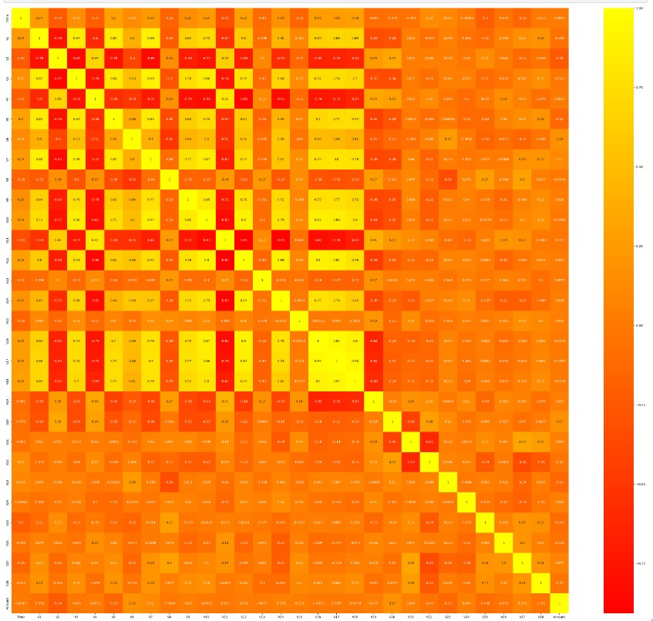
Feature Selection Techniques(Correlation)
Remove correlated features
Remove highly correlated features by using the Pearson
correlation formula.
Using threshold value 0.95 to identify highly correlated features
V16 and v17 cross this threshold value so we remove
here the V17 feature from the dataset.
Now there only 29 features.
Fig- Correlation
Figure: Correlation Matrix

Slide 14
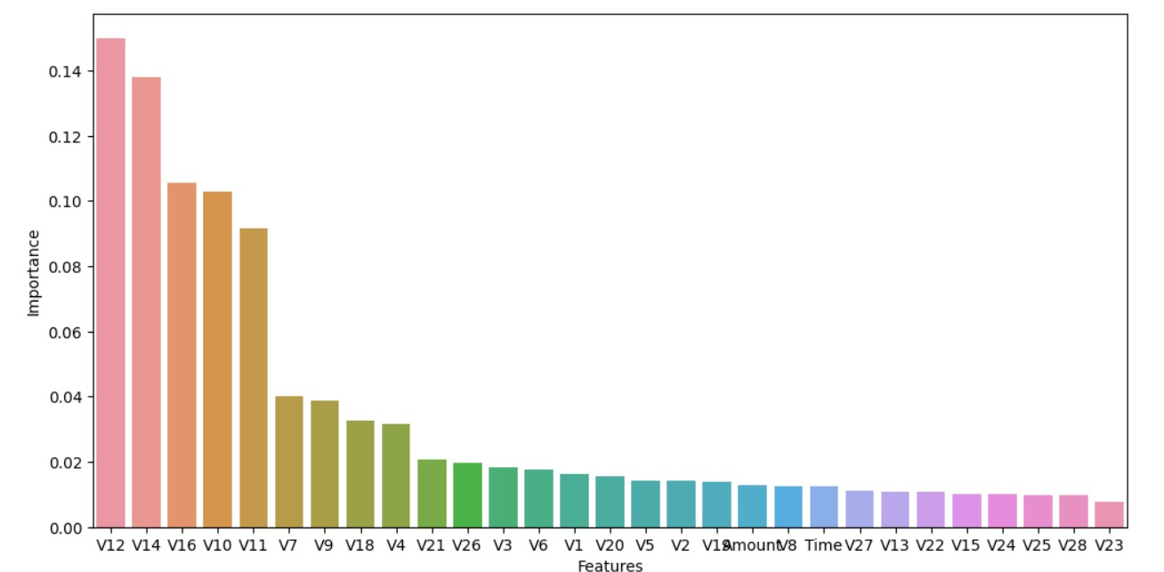
Feature Selection Techniques
Random Forest Feature Importance
Applying random forest tree methods for selecting important features using threshold value 0.015.
Now 29 features reduced to 15 important features
In figure we can see V12, V14, V16, V10, V11, V7, V9, V18, V4, V21, V26, V3, V6, V1 and V20 columns are the top selected features the importance value are more than 0.015
Figure: RF feature importance

Slide 15
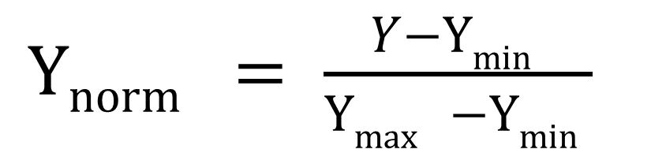
Feature Selection Techniques
Normalization
Applied to the selected features to convert them in range between 0 and 1.
In this paper use min max normalization
It converts the input data in a standard format
Training speed and model performance will be better than before.
Reduce the dimension and value range of different features.
$Ynorm = \frac{Y−Ymin }{Ymax −Ymin }$
15

Slide 16
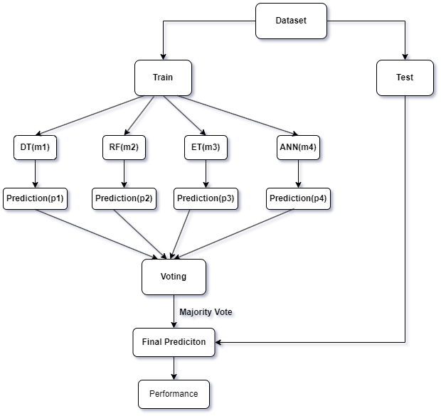
Ensemble Learning (Voting)
In this technique multiple model make the predictions then combine the prediction to get final result
Used to reduce variance and improve prediction accuracy
Training of few classifier (DT, RFT, ANN, Extra Trees) on the training dataset are shown work as base model.
Performance are voted with majority class then predict final result

Slide 17
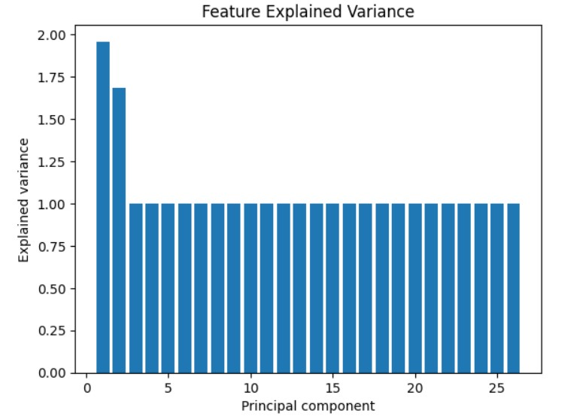
Principal Component Analysis (PCA)
It is a feature extraction technique.
The goal is to create a new, smaller set of features that contain the most useful data.
Minimize the dimensionality of features
Reduce the amount of input features
The figure shows the relationship between the explained variance and the Number of Principal components.
Principal component 3 to 26 have contain the same explained variance.
Figure: Explained Variance Ration vs. Number of Principal Components

Slide 18
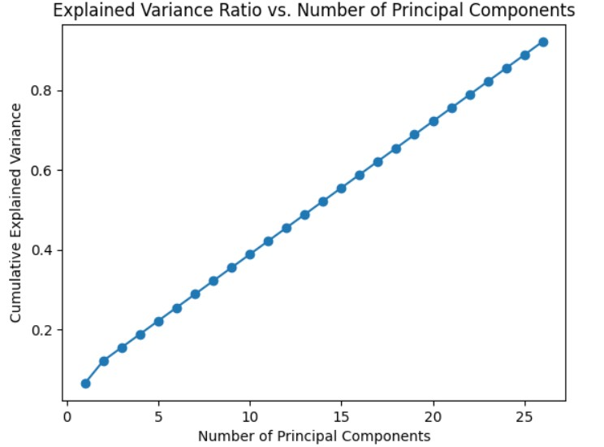
Principal Component Analysis (PCA)
This figure represent the Number of Principal components which can retain more than 90% variance of the original dataset.
26 principal components are selected as they retain more than 90% variance of the original dataset .
Figure: Cumulative Explained Variance Ration vs. Number of Principal Components

Slide 19
Genetic Algorithm(GA)
It is an evolutionary algorithm working methodology is inspired by the famous charles darwin’s theory.
It has 4 features: population, gene, chromosome and fitness value.
Algorithm of GA:
Step 1 : Initialization of population
Step 2 : set N = no. Of generation
Step 3: set i=1
Step 4: while i<= N
calculate the fitness value
Selection
Crossover
Mutation

Slide 20
Genetic Algorithm(GA)
Operation in GA:
Initialization of population: The first step where random individuals of the populations are represented as a sequence of binary string called chromosome.
Fitness value: Calculate each population fitness value. Choosing individuals for mating based on their fitness value (parents) and desired values for each is the evaluation procedure.
Selection: The selection of an individual is depends on its fitness value. The higher fitness value has more probability for selection than the lower value.
Crossover: After selecting individuals then we perform crossover operation for creating new generation. There are many technique of crossover operation :single point ,two point and multi point crossover.
Parent 1 : 100110010
Parent 2: 010111011
Crossover at point 5 the new generation
Child1 :100111011
Child 2:010110010

Slide 21
Genetic Algorithm(GA)
Mutation: after creating the new generation by using the crossover operation then we need mutation for changing the characteristics of this new generation
Child1 : 1101111000011110
Child 2: 1101100100110110
After mutation by randomly select bits 0 to 1 and vice versa.
Muted child 1 : 1100111000011110
Muted child 2 : 1101101100110100

Slide 22
Experimental Results
5 fold cross validation on 5 models (XGBC,DTC,RFC,ANN,KNN) on the train dataset and calculate their performance metric (accuracy , F1 measure).
RFC performed better in each fold than XGBC another 3 models are not performed as RFC and XGBC.
Fold | XGBC |  | DTC |  | RFC |  | ANN |  | KNN
 | ACC | F1 | ACC | F1 | ACC | F1 | ACC | F1 | ACC | F1
1 | 0.9996 | 0.9996 | 0.9985 | 0.9985 | 0.9998 | 0.9998 | 0.9657 | 0.9745 | 0.955 | 0.9562
2 | 0.9998 | 0.9998 | 0.9985 | 0.9984 | 0.9998 | 0.9998 | 0.9310 | 0.9720 | 0.952 | 0.9537
3 | 0.9998 | 0.9998 | 0.9985 | 0.9985 | 0.9998 | 0.9998 | 0.9801 | 0.9445 | 0.955 | 0.9564
4 | 0.9997 | 0.9997 | 0.9986 | 0.9986 | 0.9998 | 0.9998 | 0.9810 | 0.9798 | 0.956 | 0.9566
5 | 0.9998 | 0.9998 | 0.9984 | 0.9986 | 0.9999 | 0.9999 | 0.9769 | 0.9791 | 0.955 | 0.9559
Avg. | 0.9997 | 0.9997 | 0.9985 | 0.9985 | 0.9998 | 0.9998 | 0.9669 | 0.9699 | 0.9546 | 0.9575

Slide 23
Experimental Results(all models)
Method | Performance Metric | XGBC | DTC | RFC | ANN | KNN | Ensemble learning : Voting | Performance | Speed
Method -1 (cor_fi_nor) | ACC | 0.99 | 0.99 | 0.99 | 0.99 | 0.99 |  | Very Well | Very Fast
 | F1 | 0.862 | 0.83 | 0.868 | 0.80 | 0.85
Method -2(PCA) | ACC | 0.99 | 0.99 | 0.99 | 0.99 | 0.99 |  | Not good | Not slow
 | F1 | 0.82 | 0.83 | 0.83 | 0.82 | 0.53
Method -3(GA) | ACC | 0.99 | 0.99 | 0.99 | 0.99 | 0.99 |  | Excellent | Very Slow
 | F1 | 0.88 | 0.84 | 0.87 | 0.85 | 0.85
Method-4(Ensemble_learning) | ACC | - | - |  |  |  | 0.99 | Well | Fast
 | F1 |  |  |  |  |  | 0.85

Slide 24
Experimental Results(Method Selection)
Method-3 performed tiny better than Method-1 but it is very slow speed.
Method-2 PCA not performed well as it is a highly unbalance dataset.
Method-4 performed good but it is also a slow process.
As this dataset is highly unbalanced and after applying smote operation it consists a huge amount of data 454902 samples in total so there need a method that give high speed and better performance all this condition meet method-1.

Slide 25
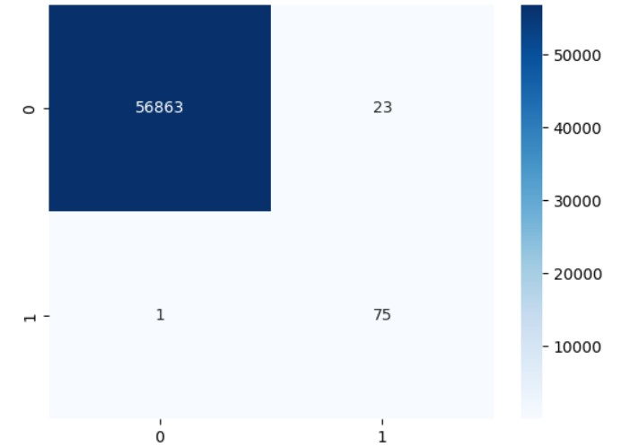
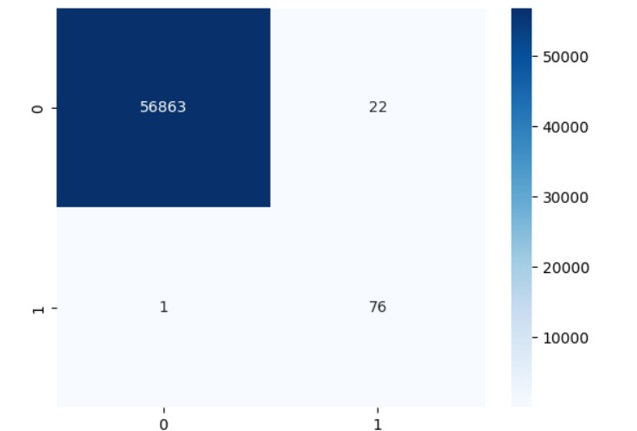
Experimental Results (Model Selection)
In Method-1 XGBC and RFC performed well as their F1 measure score is 0.862 and 0.868 respectively where DTC , KNN and ANN F1 measure score is 0.83 ,0.85 and 0.80 respectively.
Fig-1 XGBC Confusion Matrix Fig-2 RFC Confusion Matrix

Slide 26
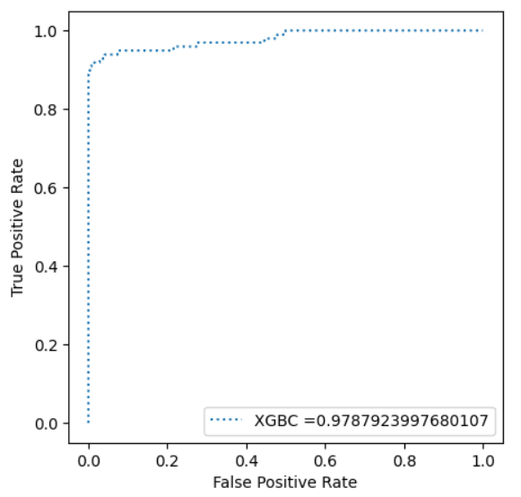
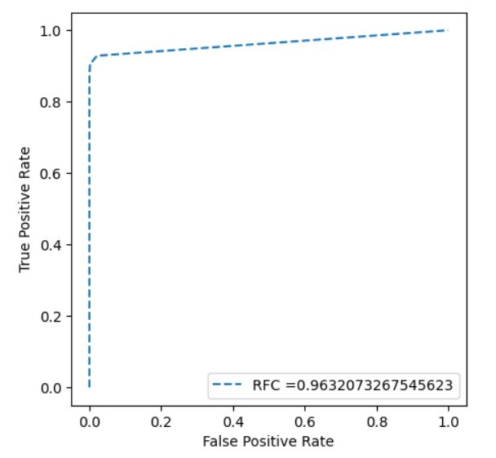
Experimental Results(Roc AUC Curve) The ROC AUC curve is a one kind of performance measurement at various threshold level for the classification problem.

Slide 27
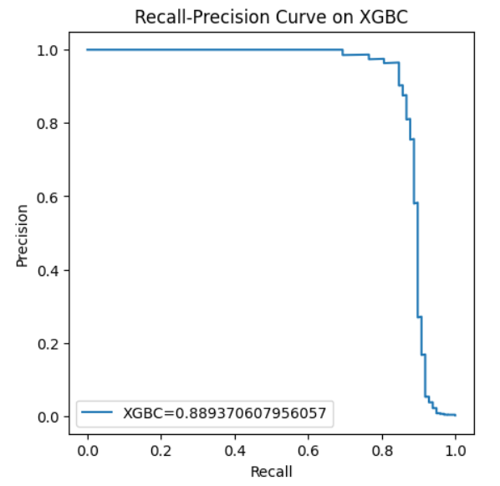
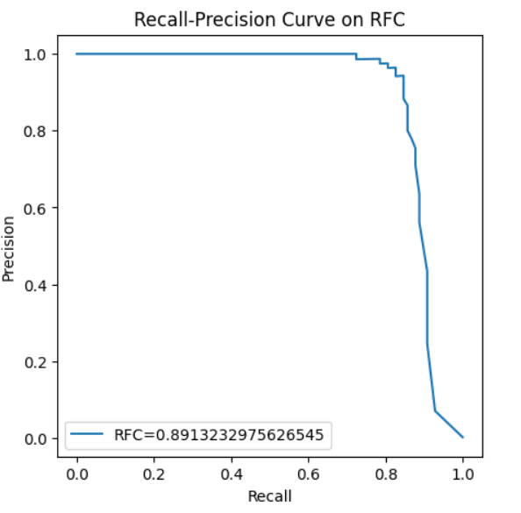
Experimental Results (Precision recall curve )
The precision-recall curve shows the tradeoff between precision and recall for different threshold

Slide 28
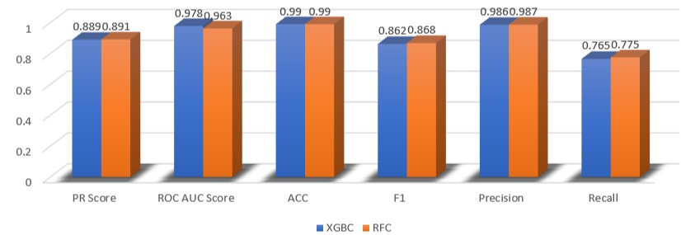
Experimental Results(Compare different metric between XGBC and RFC)

Slide 29
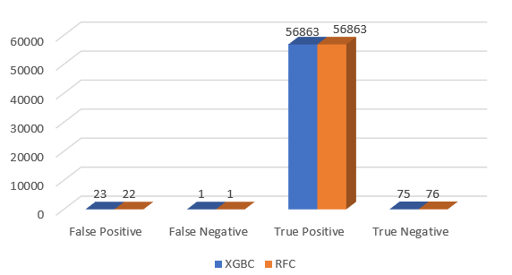
Experimental results(FP ,FN,TP and TN of XGBC and RFC)

Slide 30
Experimental Results(Model selection)
PR score ,F1 Measure ,precision and recall are high in RFC.
True Positive and False Negative are same but True Negative In XGBC is 0.131% and in RFC is 0.133% and False Positive in XGBC is 0.040% and in RFC is 0.038%.
In this method True Negative is higher in RFC and False Positive is higher in XGBC model.
For this method RFC performed better than XGBC. So we suggest RFC for this method.

Slide 31
Limitations
Although there is small amount of FP and FN that model can’t accurately detect.
As there is larger number of legitimate transactions compared to fraudulent ones so this unbalance dataset solve with an artificial technique SMOTE which is not perfect all time.
To enhance fraud detection accuracy, organizations often collect and analyze large amounts of sensitive data where data privacy some times faces challenges.

Slide 32
Conclusion
Collection of dataset from kaggle containing card transactions
Completing pre-processing of dataset and dividing the dataset into train and test split.
Then applying SMOTE- sampling technique
Applying different methods and select the best one.
Deploying dataset into machine learning algorithms
Comparing different performance metrics and choosing the best model.

Slide 33
References
[1] E. Ileberi, Y. Sun, and Z. Wang, “A machine learning based credit card fraud detection using the GA algorithm for feature selection,” J. Big Data, vol. 9, no. 1, 2022, doi: 10.1186/s40537-022-00573-8.
[2] L. K. Lok, V. A. Hameed, and M. E. Rana, “Hybrid machine learning approach for anomaly detection,” Indones. J. Electr. Eng. Comput. Sci., vol. 27, no. 2, pp. 1016–1024, 2022, doi: 10.11591/ijeecs.v27.i2.pp1016-1024.
[3] Aburbeian, A. H. M., & Ashqar, H. I. (2023). Credit Card Fraud Detection Using Enhanced Random Forest Classifier for Imbalanced Data. Lecture Notes in Networks and Systems, 700 LNNS, 605–616. https://doi.org/10.1007/978-3-031-33743-7_48/COVER
[4] V. V. Madhav and K. A. Kumari, “Analysis of Credit Card Fraud Data using PCA,” IOSR J. Eng. www.iosrjen.org ISSN, vol. 10, no. 1, pp. 2278–8719, 2020, [Online]. Available: www.iosrjen.org
[5] Sohony, R. Pratap, and U. Nambiar, “Ensemble learning for credit card fraud detection,” ACM Int. Conf. Proceeding Ser., pp. 289–294, 2018, doi: 10.1145/3152494.3156815.

Slide 34
References(Contd.)
[6] Y. Sahin and E. Duman, “Detecting credit card fraud by decision trees and support vector machines,” IMECS 2011 - Int. MultiConference Eng. Comput. Sci. 2011, vol. 1, pp. 442–447, 2011.
[7] J. K. Jaiswal and R. Samikannu, “Application of Random Forest Algorithm on Feature Subset Selection and Classification and Regression,” Proc. - 2nd World Congr. Downloads/18.pdf Comput. Commun. Technol. WCCCT 2017, pp. 65–68, 2017, doi: 10.1109/WCCCT.2016.25.
[8] N. S. Alfaiz and S. M. Fati, “Enhanced Credit Card Fraud Detection Model Using Machine Learning,” Electron., vol. 11, no. 4, 2022, doi: 10.3390/electronics11040662.
[9] V. V. Madhav and K. A. Kumari, “Analysis of Credit Card Fraud Data using PCA,” IOSR J. Eng.
www.iosrjen.org ISSN, vol. 10, no. 1, pp. 2278–8719, 2020, [Online]. Available: www.iosrjen.org

Slide 35
Q&A Session
Thank you for listening!

